Slide 1
ESG Developments Outside the
United States

Slide 2
AGENDA
Global Distribution Trends: ESG
The Asset Manager Perspective
The Investor Perspective
The Regulatory Landscape
Questions

Slide 3
Global Distribution Trends: ESG

Slide 4
Global Distribution Trends: ESG
ESG has become an increasingly critical component to attracting capital
Intense focus on ESG from European, Nordic and Dutch investors
Canadian and Australian investors are ahead of the curve – far more than Asia
U.S. coastal markets leading the way as the US plays catch-up
Marketing in Europe requires regulatory ESG awareness and there are collateral consequences for other product wrappers

Slide 5
The Asset Manager Perspective

Slide 6




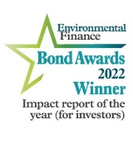




Responsible investing at Nuveen
Our commitment and market leadership
50+
years
RESPONSIBLE
INVESTING¹
790
ESG ENGAGEMENT OUTCOMES IN 2021²
30+
DEDICATED RI SPECIALISTS⁴
TOP 3
IN SUPPORT OF CLIMATE CHANGE PROPOSALS AMONG U.S. ASSET MANAGERS⁷
NAMED TO UN PRI’S
2020
Leaders’
Group⁶
NET ZERO COMMITMENTS:
TOTAL
$441.9B³
TIAA GENERAL ACCOUNT: $293.1B
NUVEEN REAL ESTATE: $148.7B
15
PROPRIETARY INVESTMENT TOOLS AND FRAMEWORKS⁵
#1
SUPPORTER OF SHAREHOLDER PROPOSALS ON DIVERSITY, INCLUSION & SOCIAL JUSTICE
ISSUES IN THE U.S.⁸
KEY ACCOLADES AND INDUSTRY INVOLVEMENT
FARMLAND GUIDELINES
A+/A
ASSESSMENT⁹
1st US Manager
TO VERIFY AGAINST IFCS
OPERATING PRINCIPLES FOR
IMPACT MANAGEMENT¹⁰
ADVANCED
ESG Manager
RATING¹¹
¹²
GPM-2313781PF-Q0622P
1 Nuveen, 31 Dec 2021. 2 Nuveen, cumulative outcomes from inception of tracking in 2019 to September 30, 2021. 3 Nuveen, 31 Dec 2021. 4 Nuveen, May 2022. 5 Nuveen, 31 Dec 2021. 6 UN PRI, 2020. 7 ShareAction, Voting Matters Report, 2020. 8 Morningstar, How Did Fund Companies Use Their Proxy Votes to Tackle Racial Inequality in 2020? 9 UN PRI, 2020. 10 The Impact Principles, 2020. 11 Morningstar, 2020. 12 Environmental Finance, 2022.

Slide 7
Putting responsible investing into action
Our foundation
Many names, one basic goal
Our objectives
Sustainable Finance
  ESG integration
  We aim to incorporate material ESG
  factors into our investment process,
  across funds and asset classes.
Business Ethics
Community Investing
Environmental
  Manage risk
Program Related Investing
Responsible Investing
SRI
Mission Related Investing
  Stewardship
  We connect using our influence with companies and issuers to help them innovate and operate more effectively, and partner with stakeholders to drive and advance ESG best practices.
Microfinance
ESG
  Uncover opportunity
Accountability
Place Based Investing
Sustainability
Triple Bottom Line
Social
Stewardship
Transparency
  Impact
  Through our investing practices,
  we seek to drive positive environmental
  and social outcomes.
Governance
  Improve long-term returns
Impact Investing

Slide 8
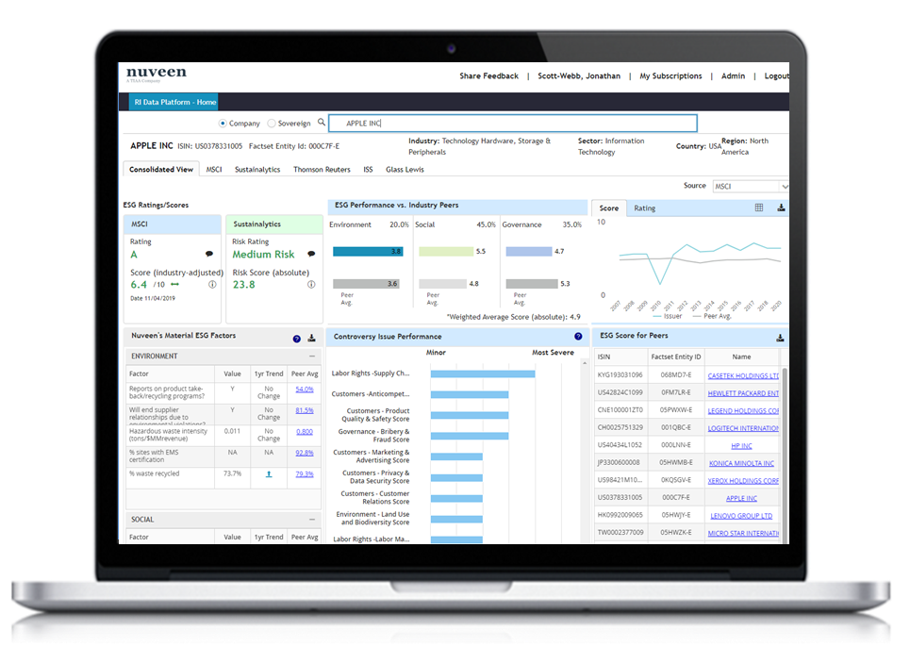
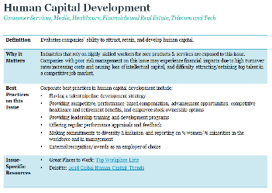
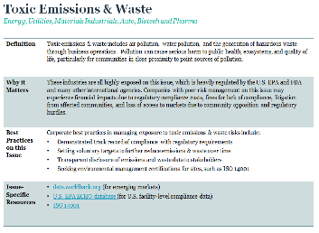
Nuveen’s approach to ESG integration
Collaborative
approach
Investment
Process
Proprietary data
and ratings
IV.
RI transparency
I.
Research
Analysts
Portfolio
Managers
III.
Monitoring & engagement
II.
Portfolio management
RI Team
Enhance investment outcomes by deepening ESG fluency and conviction among investment teams
Develop and deploy ESG integration frameworks that are leveraged by portfolio managers and research analysts
Provide investment teams with ESG training, tools, data, and reporting to strengthen investment decisions
For illustrative purposes only.

Slide 9
The Investor Perspective

Slide 10
The Regulatory Landscape

Slide 11
EU ESG Regulatory Framework
Significant ESG related legislative activity in the EU in the past two years, the key being:
Taxonomy
Regulation
Sustainable Finance Disclosure Regulation (Disclosure Regulation or SFDR)
Regulatory Technical Standards supplementing SFDR

Slide 12
EU Disclosure Regulation
Applies to “Financial Market Participants” (FMPs), including:
  AIFMs (fund manager)
  UCITS ManCos
  Portfolio Managers/Advisors
  Credit institution which provides portfolio management
  Pension Providers
Disclosure required at two levels:
  Firm
  Product
Applies in relation to “Financial Products” (FPs), including:
  AIFs (any non-UCITS fund, e.g. a private fund)
  UCITS
  Segregated Mandates
  Pension Products
Three types of mandated disclosure:
  Website disclosure
  Pre-contractual disclosure
  Periodic reporting

Slide 13
EU Disclosure Regulation
Firm (all website disclosures), including:
  Policies on integration of sustainability risks into investment activities (mandatory)
  Due diligence policies on adverse impact of sustainability risks on investment decisions (comply or explain, unless 500 employees in which case mandatory)
  Remuneration policies – consistency with integration of sustainability risks (mandatory)
Product, including:
  Pre-contractual disclosure on integration of sustainability risk in management of product (mandatory)
  Pre-contractual (and periodic) reporting on adverse impact of sustainability risks on investment decisions (comply or explain, unless 500 employees in which case mandatory)
  Additional pre-contractual, website and periodic reporting for Article 8 “light green” and Article 9 “dark green” products (mandatory)

Slide 14
EU Disclosure Regulation: Sustainability Risks
Article 3 – Transparency of sustainability risk policies – entity level
FMPs shall publish on their websites information about their policies on the integration of sustainability risks in their investment decision‐making process.
Article 6 - Transparency of the integration of sustainability risks – product level
FMPs shall include descriptions of the following in pre‐contractual disclosures:
the manner in which sustainability risks are integrated into their investment decisions; and
the results of the assessment of the likely impacts of sustainability risks on the returns of the FPs they make available.
Where FMPs deem sustainability risks not to be relevant, the descriptions referred to in the first subparagraph shall include a clear and concise explanation of the reasons therefor.

Slide 15
EU Disclosure Regulation: Sustainability Risks
Article 7 - Transparency of adverse sustainability impacts - product level
Where the FMPs consider principal adverse impacts of investment decisions on sustainability factors, the pre‐contractual disclosures (required per Article 6 SFDR) should include:
a clear and reasoned explanation of whether, and, if so, how a FP considers principal adverse impacts on sustainability factors;
a statement that information on principal adverse impacts on sustainability factors is available in the information to be disclosed in periodic reports.
Where a FMP does not consider adverse impacts of investment decisions on sustainability factors, the pre-contractual disclosures (required per Article 6 SFDR) shall include for each FP a statement that the FMP does not consider the adverse impacts of investment decisions on sustainability factors and the reasons therefor.

Slide 16
EU Disclosure Regulation: Light Green Products
Article 8 - Transparency of the promotion of environmental or social characteristics in pre‐contractual disclosures (light green products)
Where a FP promotes, among other characteristics, environmental or social characteristics, or a combination of those characteristics, provided that the companies in which the investments are made follow good governance practices, the pre-contractual information to be disclosed (per Article 6 SFDR) shall include the following:
information on how those characteristics are met;
if an index has been designated as a reference benchmark, information on whether and how this index is consistent with those characteristics.
Article 10 - Transparency of the promotion of environmental or social characteristics and of sustainable investments on websites (light green products)
FMPs shall publish and maintain on their websites the following information for each light green product:
a description of the environmental or social characteristics or the sustainable investment objective;
information on the methodologies used to assess, measure and monitor the environmental or social characteristics or the impact of the sustainable investments selected for the FP, including its data sources, screening criteria for the underlying assets and the relevant sustainability indicators used to measure the environmental or social characteristics or the overall sustainable impact of the FP;
the pre-contractual information referred to in Article 8;
the information in periodic reports referred to in Article 11.

Slide 17
EU Disclosure Regulation: Light Green Products
Article 11 SFDR- Transparency of the promotion of environmental or social characteristics and of sustainable investments in periodic reports (as it applies to light green products)
Where FMPs make available a light green product they shall include a description of the extent to which environmental or social characteristics are met in periodic reports.
The pre-contractual information and periodic report shall also include the following information pursuant to Article 6 of the Taxonomy Regulation:
Where a light green product promotes environmental characteristics (per Article 6 of the Taxonomy Regulation), the information to be disclosed as part of the SFDR pre-contractual disclosure and periodic reports includes:
information on the environmental objective(s) to which the product contributes,
a description of how and to what extent the investments underlying the FP are in economic activities that qualify as environmentally sustainable and
the following statement:
  The “do no significant harm” principle applies only to those investments underlying the financial product that take into account the EU criteria for environmentally sustainable economic activities. The investments underlying the remaining portion of this financial product do not take into account the EU criteria for environmentally sustainable economic activities’

Slide 18
EU Disclosure Regulation: Dark Green Products
Article 9 - Transparency of sustainable investments in pre‐contractual disclosures (dark green products)
Where a FP has sustainable investment as its objective and an index has been designated as a reference benchmark, the pre-contractual information to be disclosed (per Article 6 SFDR) shall be accompanied by the following:
information on how the designated index is aligned with that objective;
an explanation as to why and how the designated index aligned with that objective differs from a broad market index.
Article 10 - Transparency of the promotion of environmental or social characteristics and of sustainable investments on websites (as it relates to dark green products)
FMPs shall publish and maintain on their websites the following information for each dark green product:
a description of the environmental or social characteristics or the sustainable investment objective;
information on the methodologies used to assess, measure and monitor the environmental or social characteristics or the impact of the sustainable investments selected for the FP, including its data sources, screening criteria for the underlying assets and the relevant sustainability indicators used to measure the environmental or social characteristics or the overall sustainable impact of the FP;
the pre-contractual information referred to in Article 9;
the information in periodic reports referred to in Article 11.

Slide 19
EU Disclosure Regulation: Dark Green Products
Article 11 SFDR- Transparency of the promotion of environmental or social characteristics and of sustainable investments in periodic reports (as it applies to dark green products)
Where FMPs make available a dark green product, a they shall include a description of the following in periodic reports:
the overall sustainability‐related impact of the FP by means of relevant sustainability indicators; or
where an index has been designated as a reference benchmark, a comparison between the overall sustainability‐related impact of the FP with the impacts of the designated index and of a broad market index through sustainability indicators.
The pre-contractual information and periodic report shall also include the following information pursuant to Article 5 of the Taxonomy Regulation:
Where a dark green product invests in an economic activity that contributes to an environmental objective, the information to be disclosed as part of the SFDR pre-contractual disclosure and periodic reports includes:
the information on the environmental objective(s) (per Article 9 of the Taxonomy Regulation) to which the investment underlying the FP contributes; and
a description of how and to what extent the investments underlying the FP are in economic activities that qualify as environmentally sustainable (per Article 3 of the Taxonomy Regulation.

Slide 20
ESG Market Trends
How do the regulators view product classifications on a cross-border basis?
Distribution channels view of product classifications?
Investor sentiment – what information are investors seeking prior to committing capital?
Practical Implications
What’s happening in the United States?

Slide 21
QUESTIONS

